Slide 1

Ecological principles of sustainable development

Slide 2

Natural Resources
Rational Use as One of Aspects of Sustainable Development
Characteristics of natural resources and their classification
Environmental certification of enterprise

Slide 3

Natural resources are the basis of life for any human society.
Means of people living that are not the result of their labour are qualified as natural resources. They are water, soil, plants, animals, microorganisms, mineral products, cosmic resources (solar energy).

Slide 4
There are various classifications of natural resources. For example, with regard to the use the natural resources are divided into industrial, public health, aesthetic, scientific etc.

Slide 5

The most general classification of natural resources is by their exhaustibility. According to this classification,
All natural resources are divided into:
exhaustible;
inexhaustible.
The exhaustible resources, in their turn, are divided into:
renewable ;
nonrenewable resources.

Slide 6

A living component of the biosphere falls under the category of renewable for example, green plants, soil, fertility of which is formed within a lengthy period and is the most deficit resource. However, the rates of using the renewable resources must be conformance with the rates of their restoration; otherwise the renewable resources may become nonrenewable.

Slide 7


Coal, petroleum, and natural gas are
considered nonrenewable because they can not be replenished in a short period of time. These are called fossil fuels.

Slide 8
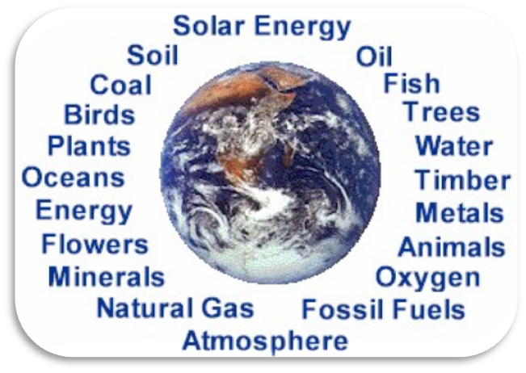
Cosmic, climatic and water resources fall under the category of the inexhaustible resources.

Slide 9
- The cosmic resource is solar radiation.
Climatic resources are the atmospheric air, atmospheric precipitation, wind.
Water resources are water reserves of the Earth. This resource is inexhaustible on a global scale, but on a local scale it may be exhausted (for example, the Aral Sea).

Slide 10
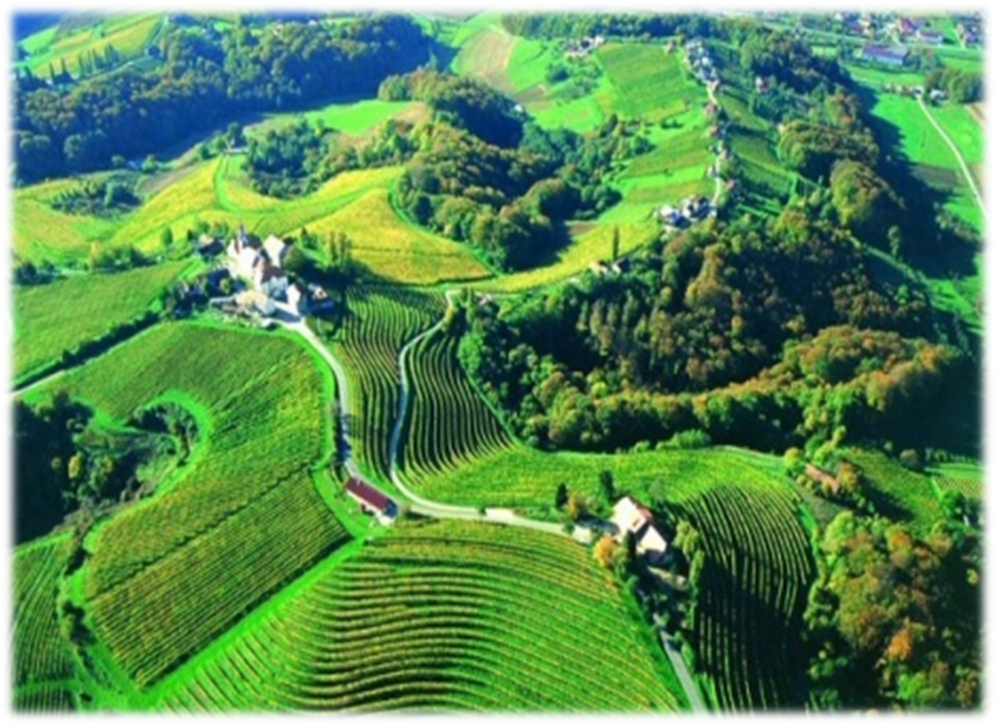
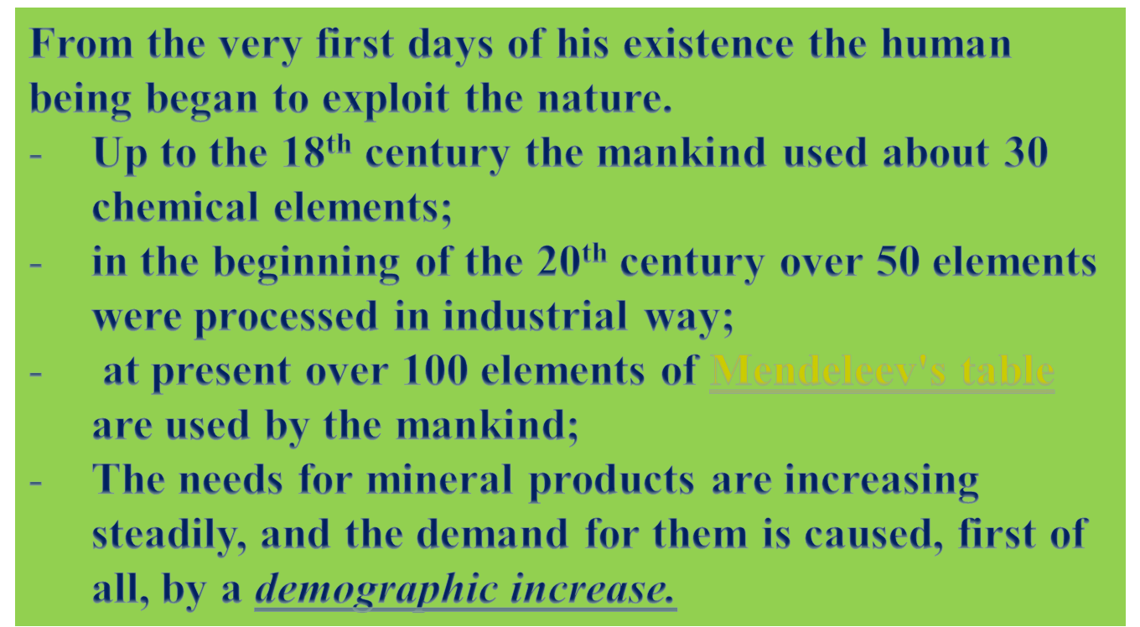

Slide 11



Slide 12
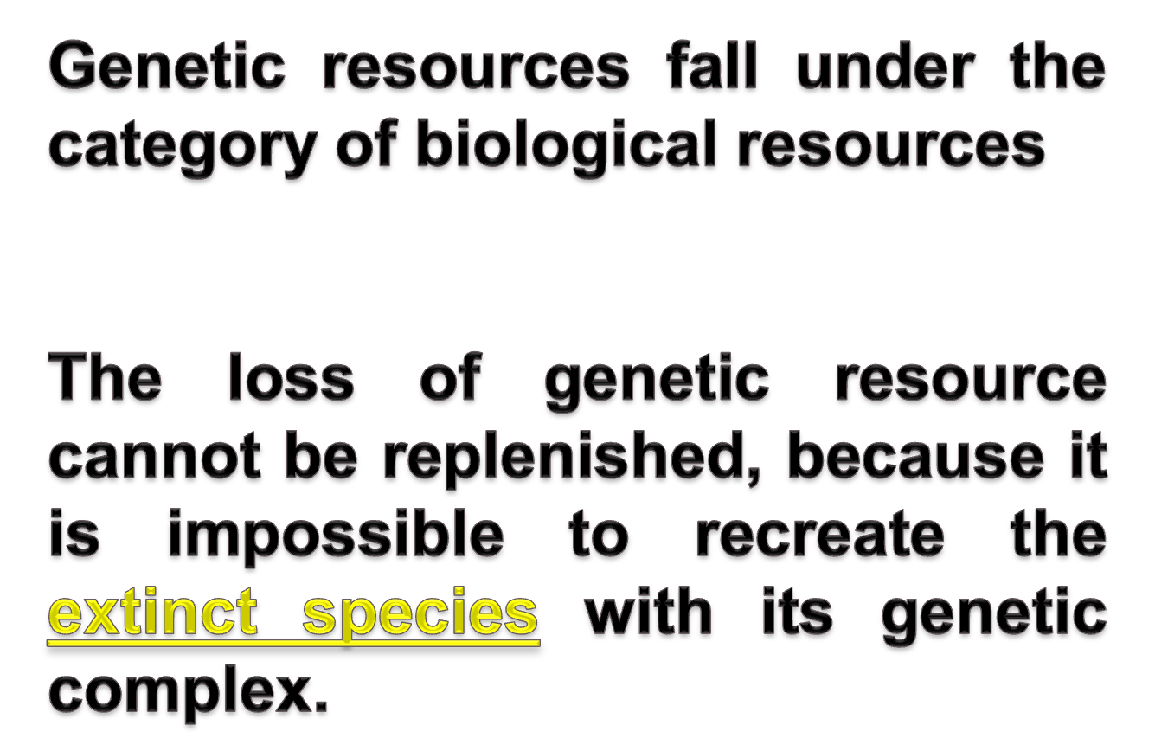

Slide 13
The rational nature management has twofold aim;
it is necessary to attain the preservation of nature with all its diversity;
provide the growth in prosperity of the population.

Slide 14
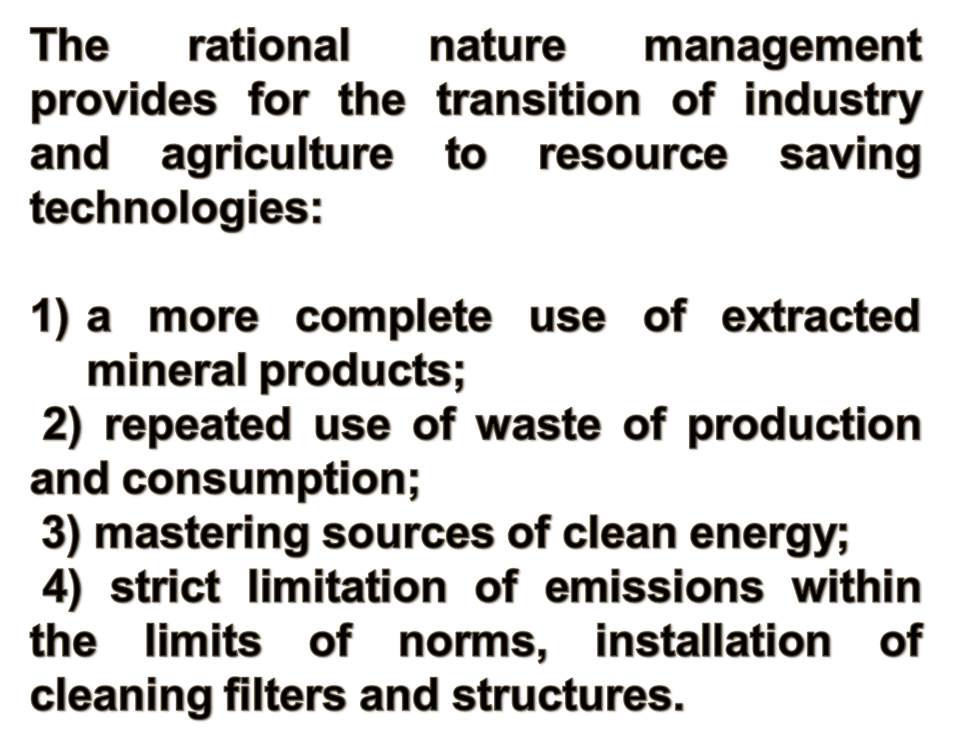

Slide 15

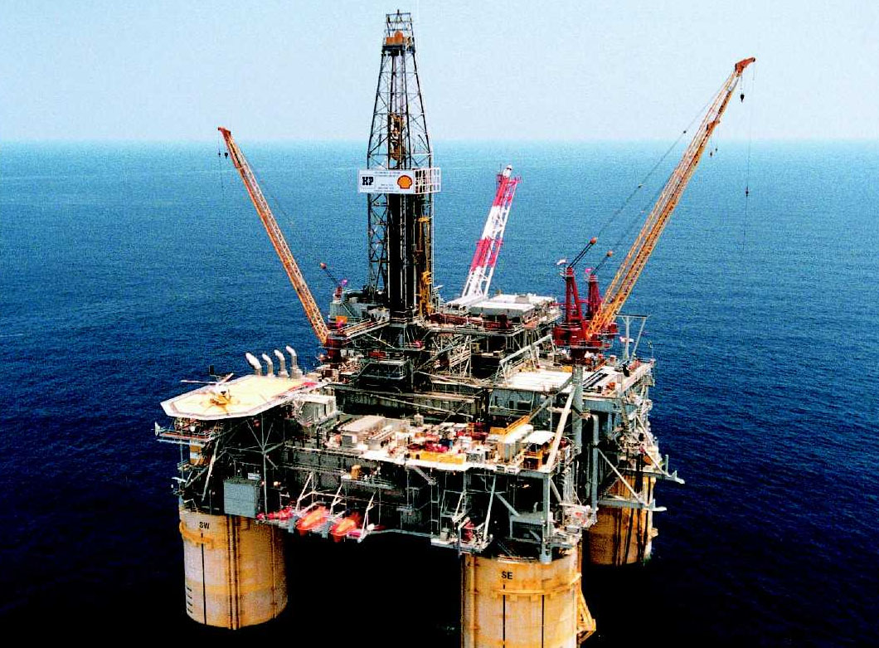
It is necessary to remember that the natural resources are a part of ecosystems, in which all ecological components are interrelated.

Slide 16
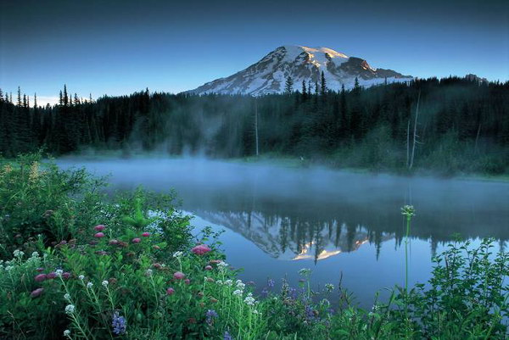
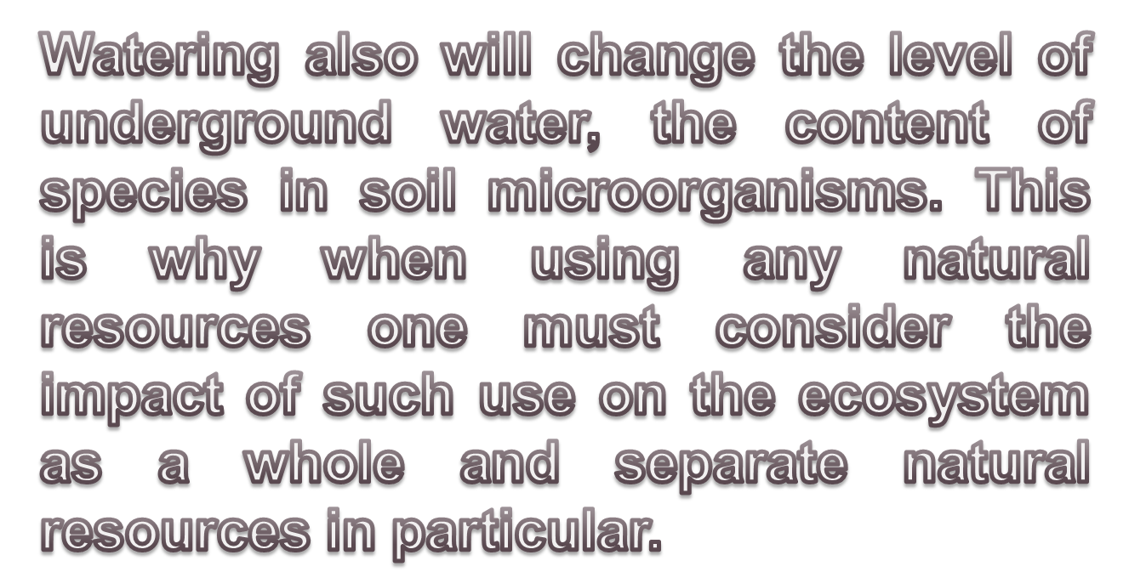

Slide 17

One of forms of environment protection being of exclusive value is protected areas.
The forms of protected areas:
Reserves;
Wildlife sanctuaries;
Natural monuments;
National and natural parks;
Botanical gardens;
Biosphere reserves.

Slide 18

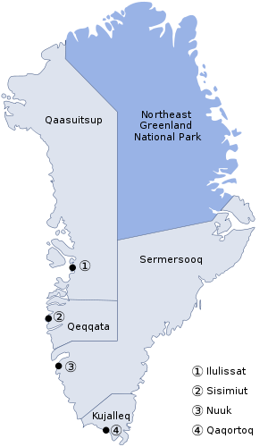
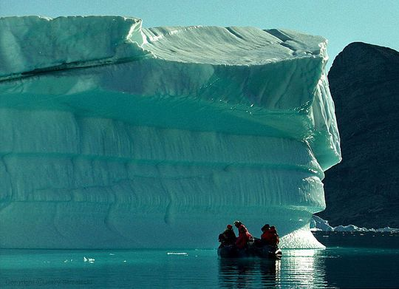
National Park of Greenland – 7 million hectares;

Slide 19
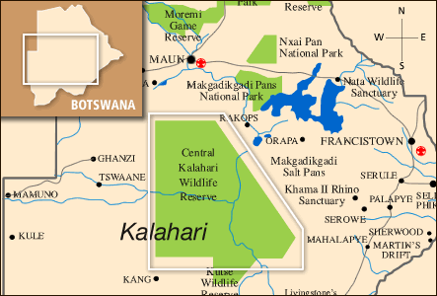
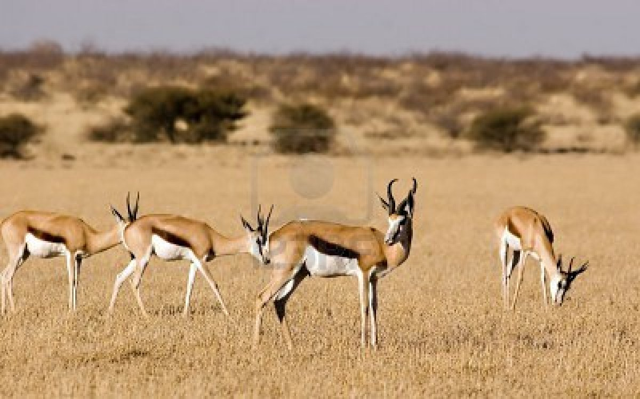
The Central Kalahari Game Reserve, Botswana – 5.3 million of hectares;

Slide 20
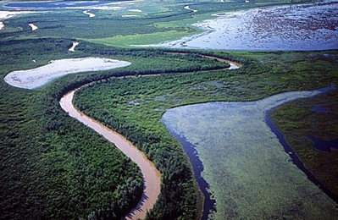
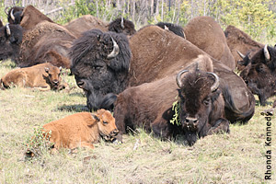
Wood Buffalo National Park, Canada – 4.5 million of hectares.

Slide 21

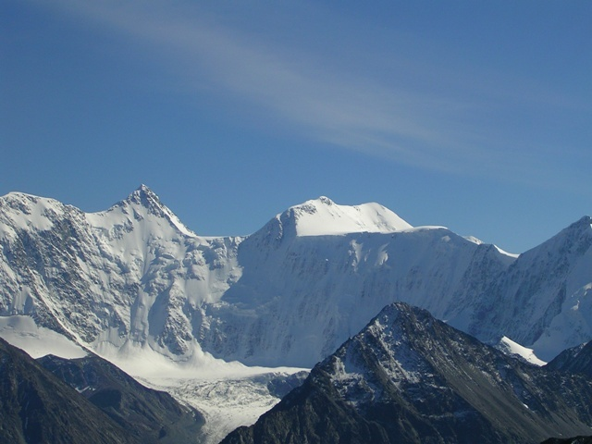
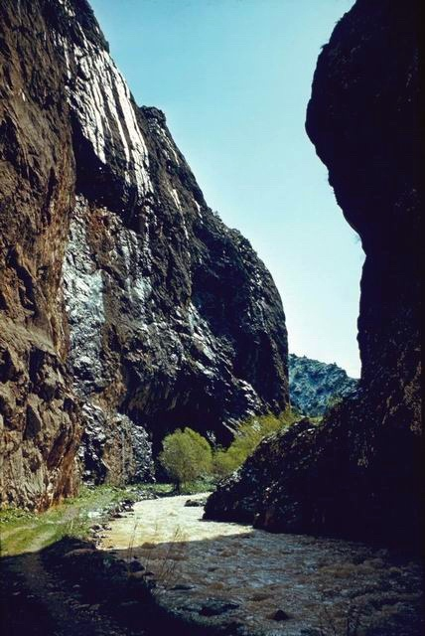

There are operating 10 reserves:
Aksu Zhabagly, Barsa-Kelmes, Almaty
Reserve, Naurzumsky, Kurgaldzhinski,
Markakolski, Ustyurt, Alakol, West Altai,
Karatau.

Slide 22

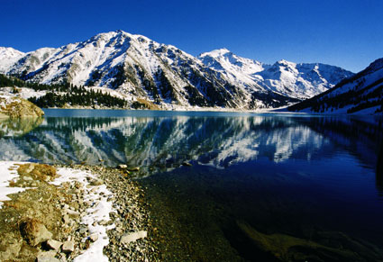
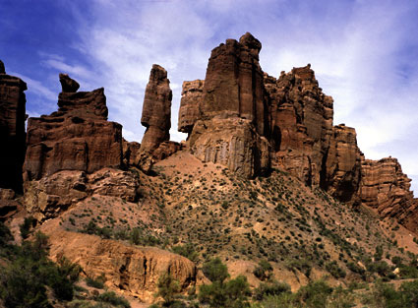
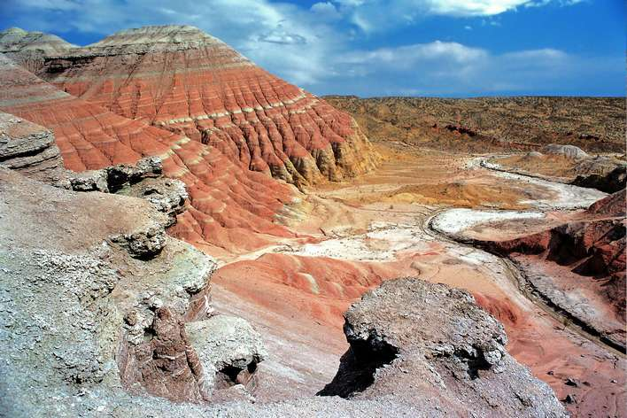
There are 8 National Nature Parks:
Bayan Aul, Ile-Alatau, Altyn Emel,
Kokshetau Burabay, Karakaralinskiy,
Katon-Karagay, Charyn.

Slide 23
In June 1992, at the World Forum in Rio de Janeiro the Convention on Biological Diversity was signed and ratified by more than 100 states of the world. The main aim of the Convention shall be to sustain the rich diversity of life on Earth and sustainable use of its elements.

Slide 24
The International Conference on Biosphere Reserves (Seville, 1995) developed the Seville Strategy for Biosphere Reserves and the Role of Biosphere Reserves in the 21st century.

Slide 25
The biosphere reserves shall fulfill three complementary functions as follows:
protection to sustain genetic resources, biological species, ecosystems and landscapes;
the function of development to promote sustainable economic and human development;

Slide 26
the function of material and technical support to promote and encourage activities in the field of research, education.

Slide 27

The concept of monitoring was introduced into the scientific literature in early seventies of the last century, and it means observation and exercising control over changes in the state of biosphere and ecosystems, populations, organisms influenced by human activities, and also the atmosphere, the water, the soil and human health.

Slide 28

Tracking and control is a systematic environmental monitoring;
Forecast is to determine probable changes of weather under the influence of natural and anthropogenic factors;
Management is measures and actions to regulate the state of environment.

Slide 29

Sanitary and Hygienic Indicators
Maximum permissible concentrations
(MPC) of contaminants in the air, water,
soil, food products;
Maximum permissible emissions (MPE)
of contaminants in the air, water bodies.
Ecological Indicator
Regarded as a measure of anthropogenic
impact on ecosystems

Slide 30
An important indicator of the state of environment is the health of population, the criteria of which are the infant mortality dynamics, congenital anomalies of newborn infants, diseases of children and adults.

Slide 31
With the intent to build harmonious relations between the nature and society it is necessary to solve three the most important tasks:
To form a new type of social and ecological thinking eliminating an exclusive consumer approach to the nature;

Slide 32
Wide publicity, enlightenment and education of social and ecological problems accompanying development of human civilization;
Developing a business mechanism of nature management providing full coordination of individual, collective and national interests in the area of environment protection and rational use of natural resources.

Slide 33


Slide 34



Environmental (ecological) certification is a form of environmental regulation and effective measures for environmental protection and improvement of the ecological situation. .

Slide 35
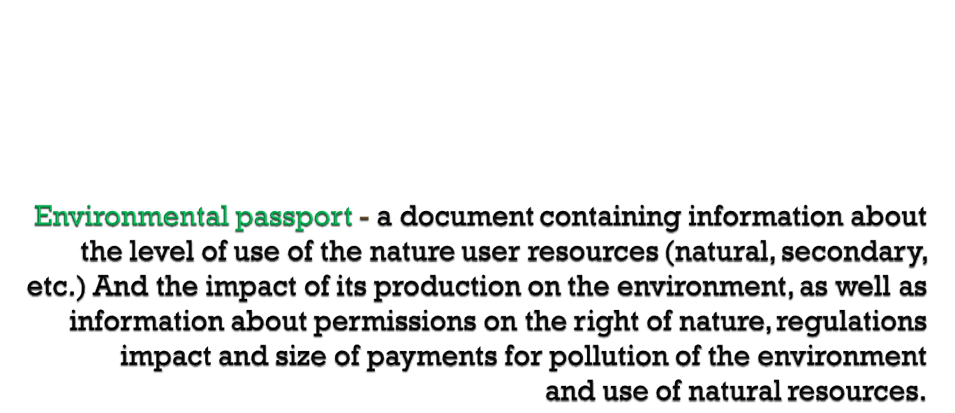
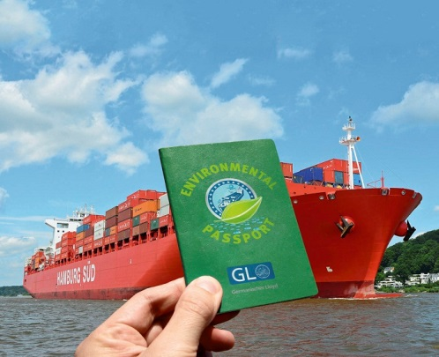

Slide 36
Ecological passport of the company refers to its basis and technological documentation, it should be in every enterprise.

Slide 37
Environmental Passport gives you the opportunity to analyze the ecological state of the enterprise and the environment in the region, to compare the ecological and economic performance with other better environmental protection measures.

Slide 38

title page,
information about the developer of environmental passports
content,
general information about the users of natural resources,
environmental and economic indicators,
information about products,
a brief description of production,

Slide 39
information on the consumption of energy,
ecological and production figures,
information on land use,
information about permissions (licenses) for the use of natural resources and environmental protection activities,
Environmental Action Plan,
a list of references.

Slide 40
Environmental certification of enterprise
environmental assessment of production in terms of rational use of natural resources
consumption of raw materials
consumption of energy
consumption of natural resources
emissions of pollutants per unit of production
assessment of the negative impact on the environment
Gross amount of disposing
Gross number of discharges
Gross amount of solid waste
availability and effectiveness of treatment facilities
relationship management "enterprise - environment" by levying pollution charges

Slide 41

1st group: indicators of influence on a state of the environment;
2nd group: indicators of organizational and technological level of environmental performance of the enterprise;
3rd group: general and specific indicators of cost-benefit analysis for environmental activities.

Slide 42

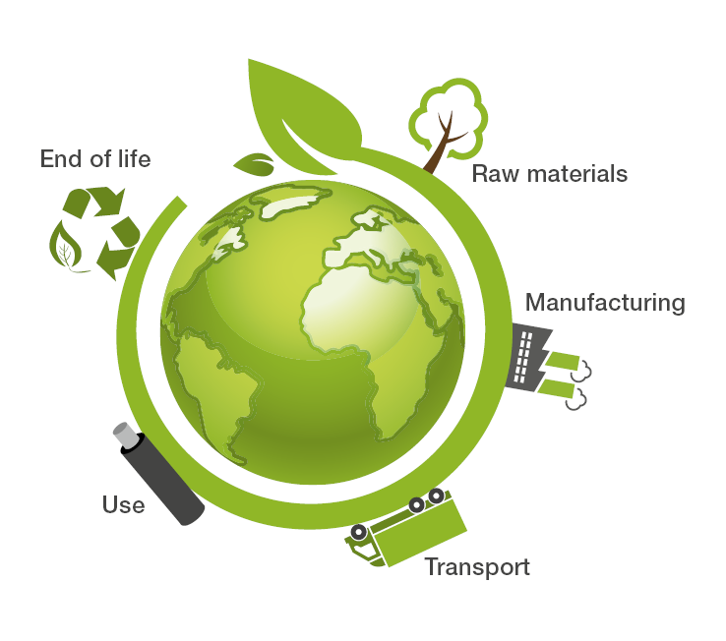
environmentally friendly products;
the impact on water resources;
the impact on the atmosphere;
impact on material resources and waste production;
the impact on land resources.

Slide 43

equipment pollution sources pollution control equipment;
capacity of existing sewage treatment plants;
progressivity used cleaning equipment;
the ability to control the operation of pollution control equipment;
the rationality of the existing organizational structure of the environmental performance of the enterprise;
specific indicators of organizational and technological level of environmental performance of the enterprise.

Slide 44

It includes a general indicator of the ratio of the economic effect of environmental protection measures to the total amount of expenses for their implementation and a set of partial indicators.
These include:
the share of capital expenditures for environmental protection in the total capital cost of the enterprise;
the share of current expenditure on environmental protection in the total current cost of the enterprise;
share of expenses for the protection of air pool in the total expenditure on environmental protection;
the proportion of the cost of protection and rational use of water resources in the total expenditure on environmental protection;
share of costs for the destruction and disposal of solid and liquid waste in the total expenditure on environmental protection;
share of expenses for the development and implementation of advanced technologies (low-waste, non-waste, drainage, etc.) in public expenditure on R & D;
the share of costs for the services of outside organizations on environmental protection in the total cost of the enterprise.

Slide 45
Drawing up of the ecological passport is quite complicated procedure, so it is usually drawn up not by the enterprise, and on his behalf by a commercial organization having a license.
Work on the ecological passport now paid under the arrangement with a commercial organization.
Environmental Passport signed by the director and the head of the regional organization of environmental protection and natural resources. Subsequently, the document specifies it made the necessary changes.

Slide 46

The main purpose of the environmental certification is to provide a wide range of users of information for scientific, organizational and practical tasks aimed at environmental management. We give a systematic summary of the data on the current state of natural complexes of the territory and the impact of anthropogenic factors. This certificate is intended for the territory of the administrative area, but can be used for other territorial entities. By the passport attached atlas thematic maps drawn and general ecological map of the territory. At the end of the document given to the conclusion of the environmental situation, which is actually an environmental certification of the territory.

Slide 47

1. Bekenova G.S. Ecology and Sustainable Development. Lecture book/ Almaty: Suleyman Demirel University, 2014. – 112 p.
3. https://ru.wikipedia.org/wiki/
2.http://www.grandars.ru/college/ekonomika-firmy/ekologicheskiy-pasport-predpriyatiya.html

Slide 48

